Slide 1

MSCI 311
Organizational Design and Technology
Instructor: Ayman Alzayat, aalzayat@uwaterloo.ca
TA: Varsha Suryanarayana, vsuryana@uwaterloo.ca

Slide 2
Ashby’s Law of Requisite Variety
Variety vs. Uncertainty
Ashby’s Law of Requisite Variety
Applications in Organizations
Example of Just-in-Time Manufacturing

Slide 3
Background
Definition
W. Ross Ashby: “An Introduction to Cybernetics”
Cybernetics: “the science of control and communication, in the animal and in the machine”
dynamic systems - respond to perturbation.
When a dynamic system is perturbed by a disturbance, it will provide a response. The relationship between the response and the disturbance will determine the eventual outcome.
Why do we care about Ashby’s Law of Requisite Variety?
Because it provides a useful conceptual framework for thinking about organizations.

Slide 4
The Law of Requisite Variety
Idea of a dynamic system
Examples of concepts
Stable output
Relaxation time
Negative feedback

Slide 5
The Law of Requisite Variety
Process of regulation
Ashby’s game
R
a’
b’
c’
a
2
1
3
D
b
1
3
2
c
3
2
1

Slide 6


The Law of Requisite Variety
Examples
Games
Absorb your opponent’s variety to avoid losing
Try to generate variety that the opponent can’t generate to win
Driving
Q: Can you describe how driving a car illustrates Ashby’s Law of Requisite Variety?

Slide 7
The Law of Requisite Variety
Shannon’s model of the communication process
Message Sent
Noise
Message Received
Source
Transmitter (Encoder)
Channel
Receiver (Decoder)
Destination
Communication = transmission of a message, selected from a set of possible messages
Destination experiences uncertainty about which message from the set has been sent
Communication works when the message sent by the source, is correctly identified at the destination

Slide 8
The Law of Requisite Variety
The relationship between variety and uncertainty:
Uncertainty:
Recall that uncertainty is a gap in information
Hence, The higher the variety (the number of possible system states), the more uncertain the system is, and the more information is required to specify the current state of the system

Slide 9
The Law of Requisite Variety
Variety and Uncertainty
Both concepts deal with the amount of complexity and change encountered by a system
Both are based on mathematical “Information Theory” (Shannon & Weiner)
Uncertainty is a measure of the amount of information needed to know the state of a system precisely
Uncertainty is proportional to the variety of the system
As variety increases, uncertainty increases and the amount of information needed to eliminate uncertainty increases.

Slide 10

The Law of Requisite Variety
The Law of Requisite Variety: “Only variety can destroy variety”
Variety in outcome >= variety of D/variety of R or only variety can destroy variety
Definition of Requisite Variety:
Minimum amount of variety that must be generated by system to control for a desired outcome, given all sources of disturbance variety
Possible states:
When the system doesn’t have enough variety to cope with the variety presented by the disturbance, then the system can not control the outcome
The more response variety the system can acquire, the more can the variety of the outcomes be reduced

Slide 11

The Law of Requisite Variety
Application to Organizations
Disturbance Variety (V_{D}) that affects the organization includes
Sources of External Disturbance Variety (V_{DE})
Sources of Internal Disturbance Variety (V_{DI})

Slide 12
The Law of Requisite Variety
Application to Organizations
Sources of V_{DE}
Customers. (E.g., changing customer preferences)
Suppliers. (E.g., changing lead times, packaging, pricing, etc.)
Competitors (E.g., changing competing products, new features, lower prices, etc.)
Other (E.g., government, weather, etc.)
Organization
Customers
Suppliers
Competitors
Other

Slide 13
The Law of Requisite Variety
Application to Organizations
Sources of V_{DI}
Employees. (E.g., different training and skill level, different goals and ambition, etc.)
Technology. (E.g., technology can be very rigid, trying to get technology to work with a new exception can create new problems (i.e. variety))
Bureaucracy. (E.g., similar to technology)
Employees
Bureaucracy
Technology

Slide 14

The Law of Requisite Variety
How do organizations cope with disturbance variety?
Recall:
In order to maintain V_{o} at a minimum, an organization can:
Decrease the disturbance variety V_{D}
Increase response variety V_{R}

Slide 15
The Law of Requisite Variety
1- Mechanisms to decrease disturbance variety V_{D}
Constraints / Rules
E.g. office hours, assignment length
Filters
E.g. positive reporting as filters in communication
Grouping of the input
E.g. grouping of engineering students in programs
Eliminate variety
E.g. price fixing
And more…
E.g. mechanisms from “Managing Environmental Uncertainty”.

Slide 16
The Law of Requisite Variety
2- Mechanisms to increase response variety V_{R}
Buffer between organization and source of variety
E.g. inventory
Increase information processing capacity
Sophisticated ERP systems
Slack resources
E.g. back-up equipment, redundant employees, shifts
And more…
E.g. Mechanisms from “Managing Environmental Uncertainty”.

Slide 17
How do you measure variety in organizations?
Example: interactions in a software company
Examine unit-to-unit interactions (e.g., QAO – Spec Writers)
Use the ‘Echo’ method (i.e., ask “What does X do that is helpful/unhelpful?”)
Count examples of positive and negative interactions
QAO
Spec
Writers

Slide 18
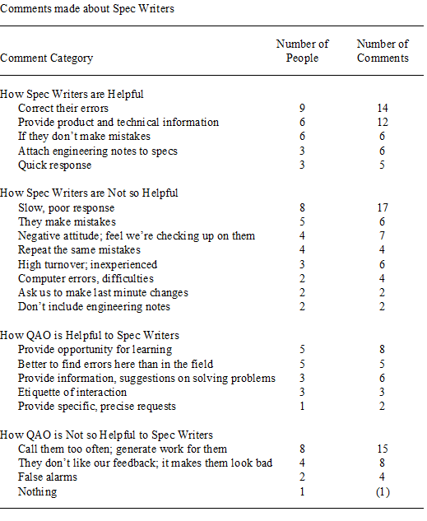

Slide 19
Application of Ashby’s law
Coupling in organizations
Internal vs. external
Measure of effectiveness
Job design
Variety matching
Just in time manufacturing
What is inventory?

Slide 20
Case Study: The Toyota Way The 14 principles
Principle 1 – Base your management decisions on long term philosophy, even at the expense of short term financial goals. Principle 2 – Create continuous process flow to bring problems to the surface. (Just In Time) Principle 3 – Use pull systems to avoid ‘overproduction’.
Principle 4 – Level out the workload. (Eliminate waiting)
Principle 5 – Build a culture of ‘stopping to fix problems’ to get quality right. (Eliminate rework) Principle 6 – Standardized tasks are the foundation for continuous improvement and employee empowerment. Principle 7 – Use visual controls so no problems are hidden. (Opportunities are exposed to all)

Slide 21
Case Study: The Toyota Way The 14 principles
Principle 8 – Use only reliable and thoroughly tested technology that serves your people and processes.
Principle 9 – Grow leaders who thoroughly understand the work, live the philosophy and teach it to others.
Principle 10 – Develop exceptional people and teams who follow your company’s philosophy.
Principle 11 – Respect your extended network of partners & suppliers by challenging them and helping them improve.

Slide 22
Case Study: The Toyota Way The 14 principles
Principle 12 – Go and see for yourself and thoroughly understand the situation.
Principle 13 – Make decisions slowly by consensus, thoroughly considering all options and then implement rapidly.
Principle 14 – Become a learning organization through relentless reflection and continuous improvement.
Class Discussion: Pick one or two of the principles and explain the principles in terms of variety (disturbance, response or output).

Slide 23
Summary of Chapter Material
Ashby’s Law of Requisite Variety presents us with a useful conceptual framework through which to analyze organizations and their interactions with their internal and external environments
Many of the actions taken by organizations to manage organizational uncertainty can be thought of as mechanisms to reduce (external and internal) disturbance variety and to increase response variety.
According to this model, organizations seek to control the outcomes by reducing the variety of outcomes that are possible

